Slide 1
Cluster Analysis Tutorial
BAMA 509
November 7, 2017

Slide 2
Cluster Analysis
We’ll be using cluster analysis to:
Identify the number of segments based on benefits sought
Assign each customer to a segment
Describe each segment (based on customer demographics)

Slide 3
Chewing Gum Data
Respondents rated the following statements on a 7-point Likert scale:
I like a gum that gives shiny teeth.
It is important to buy a gum that prevents cavities.
I prefer a gum that freshens breath.
Chewing gum should strengthen gums.
The most important consideration in buying a gum is attractive teeth.
Prevention of tooth decay is not an important benefit offered by a gum.
30 Respondents
Demographics: Gender and Age
6 attitudinal variables
Each of the variables is measured on a scale from 1 to 7
This one is reverse coded!

Slide 4
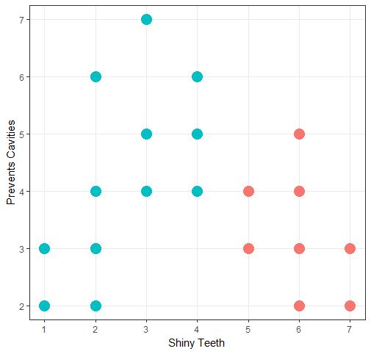
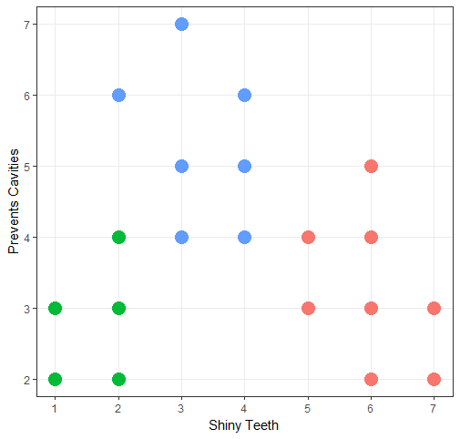
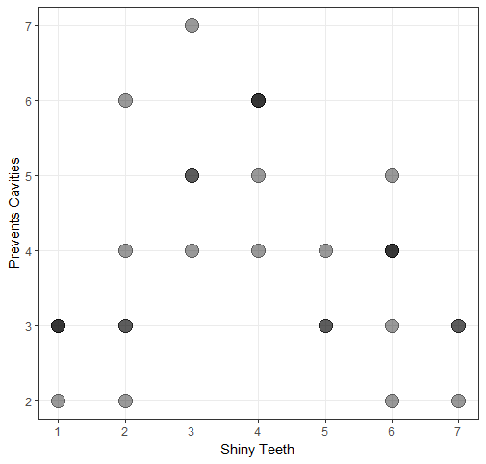
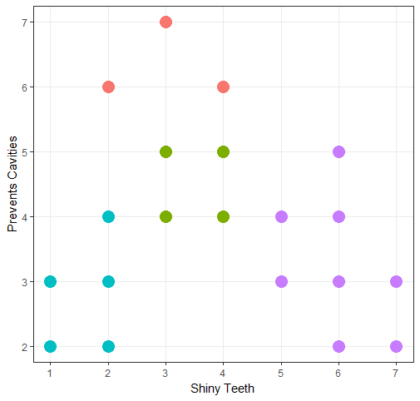
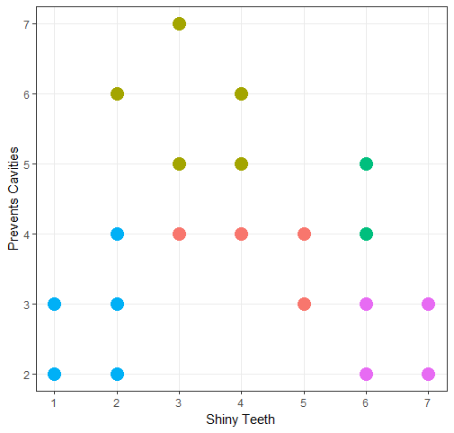
Number of Clusters
2
3
Original data (2 variables)
4
5
How many clusters?
Notes:
Is it easy to determine the number of clusters? Now imagine estimating the number of clusters in 6 dimensions.

Slide 5
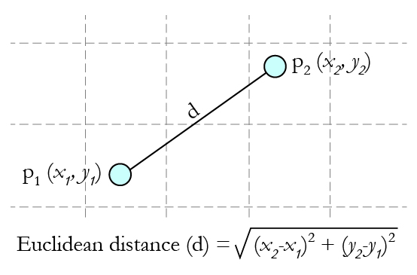
Number of Clusters
First, we need to establish the number of clusters in the data
To do so, we will use Hierarchal Cluster Analysis
In marketing, Ward’s method of Hierarchal clustering is generally most appropriate, using the squared Euclidian distance metric to determine how far or close two individuals are in the attribute space
A dendrogram produced by hierarchal clustering will help us to determine the most appropriate number of clusters
Image: http://mcla.ug/blog/k-means-clustering.html
Notes:
How does it work? Optimization! The objective functions is to minimize total within-cluster variance. At each step, find the pair of clusters that leads to minimum increase in total within-cluster variance after merging.

Slide 6
Hierarchal Clustering in R
First, calculate the Euclidian distances for response variables 1 to 6
d <- dist(gums[, c("V1", "V2", "V3", "V4", "V5", "V6")])
Then, apply Ward’s linkage clustering on your matrix of distances
h <- hclust(d, method = "ward.D2")
(Note: the same results could be obtained by using the “ward.D” method on the matrix of squared distances, and then taking the square root of heights)
h <- hclust(d, method = "ward.D")
sqrt(h$height)

Slide 7
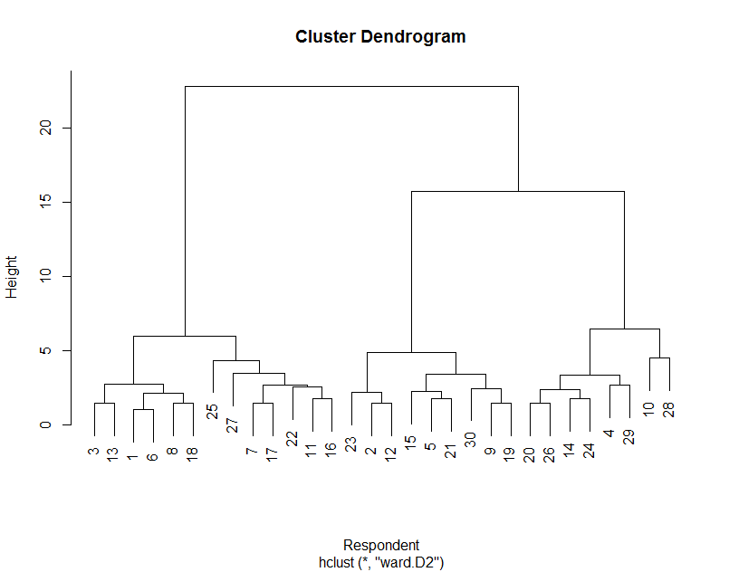
Hierarchal Clustering Analysis
The dendrogram generated is shown in the Rstudio Plots window, from where it can be saved as an image in graphic formats like png, tif, etc.
Use the dendrogram to determine how many clusters may be extracted. The vertical axis represents the distance (i.e., dissimilarity) between groups of cases. The height of a given cluster indicates the level of heterogeneity within that cluster. Ultimately, the purpose of clustering is to create homogeneous groups of cases.
There seem to be 3 viable groups in this dataset. After deciding on the number of useful clusters, we will use K-means clustering to calculate a cluster solution.
Look for jumps along the vertical axis, indicating that two dissimilar clusters have been grouped together.
Notes:
Distance between cluster centers – what is a cluster center? A point which is at a minimal distance from all the other points in the cluster (analogy: linear regression through a cloud of points)
Note – there are other criteria to select the number of clusters. NbClust in R is a package which can help you evaluate the number of factors using approx. 30 different criteria from literature.
Height (y axis) is a measure of the total within-cluster variance.

Slide 8
K-means Clustering in R
Once we have determined an appropriate number of clusters to extract, use the K-means algorithm to designate them.
Hierarchical clustering is useful in determining the number of groups emerging from the data, while the K-means clustering procedure is flexible and robust in finding the most appropriate groupings of individuals.
Next, we form 3 actual clusters using K-means.
First, standardize the input variables (z-scores)
d <- scale(gums[, c("V1", "V2", "V3", "V4", "V5", "V6")], center = TRUE, scale = TRUE)
Since the k-means algorithm starts with a random set of centers, setting the seed helps ensure results are reproducible
set.seed(1)
Apply K-means clustering (default algorithm)
k <- kmeans(z, centers = 3)
Notes:
Why not simply use the clusters we got from hierarchal clustering? Multiple mathematical reasons… In general terms, we’re optimizing simultaneously, rather than steo-by-step
K means assumptions: http://scikit-learn.org/stable/auto_examples/cluster/plot_kmeans_assumptions.html
K-means algorithm:
Start by selecting k random centers.
Calculate the distance between each point and each center
Assign each point to the closest center
Recalculate the cluster centers
Calculate the distance between each point and each center
Reassign if needed
Continue until all points remain in their assigned clusters (or for a max number of iterations)
Can be dependent on the initial selection of the centers (i.e. why we set the seed)
Think: local vs global optimum
What to do if there are multiple local optima, and you get a different answer on every iterations?
“Bootstrapping” is an option (i.e. repeat many times, and select the most popular solution)
Why standardize? So that all variables have equal “weight” on the output.

Slide 9
K-means R Output
R’s K-means procedure creates a clustering vector designating membership in either one of 3 clusters.
Since we assigned to output to object k, the results can be viewed using the command k$cluster.
The first row in the output corresponds to the row number in the dataframe (i.e. each respondent), while the second row indicates cluster membership.
> k$cluster
1 2 3 4 5 6 7 8 9 10 11 12 13 14 15 16 17 18 19 20 21 22 23 24 25 26 27 28 29 30
2 3 2 1 3 2 2 2 3 1 2 3 2 1 3 2 2 2 3 1 3 2 3 1 2 1 2 1 1 3

Slide 10
Cluster Analysis: K-means Interpretation
Summary statistics in the kmeans() output describe the groups of individuals assigned to each cluster by the number of cases and average scores for the variables used.
We generally look for values that stand out: either very high or low averages. If there are no major differences in the average value of a variable across clusters, that variable is not useful to differentiate the segments of people.
Cluster sizes:
> k$size
[1] 8 13 9
(Output is in numerical order, i.e. clusters 1, 2, 3)
Cluster means:
Note that the default values correspond to the z-scores. For interpretation, convert back to original units.
> round(sapply(c("V1", "V2", "V3", "V4", "V5", "V6"), function(n) k$centers[, n]*sd(gums[,n]) + mean(gums[,n])),4)
V1 V2 V3 V4 V5 V6
1 3.38 5.75 3.25 6.00 4.25 5.88
2 5.85 3.38 6.15 3.38 6.08 3.77
3 1.67 3.00 1.89 3.44 2.44 3.22
Shiny Teeth
Prevents Cavities
Freshens Breath
Strong Gums
Attractive Teeth
Prevents Tooth Decay
Which variables seem to most clearly distinguish the different clusters?
Generate a label for each group that describes them and the ways they differ from others.
Notes:
Work in pairs to come up with answers to the bottom questions.
1 – Healthy
2 – Attractiveness (Esthetics)
3 – Generally indifferent
Record answers on the board

Slide 11
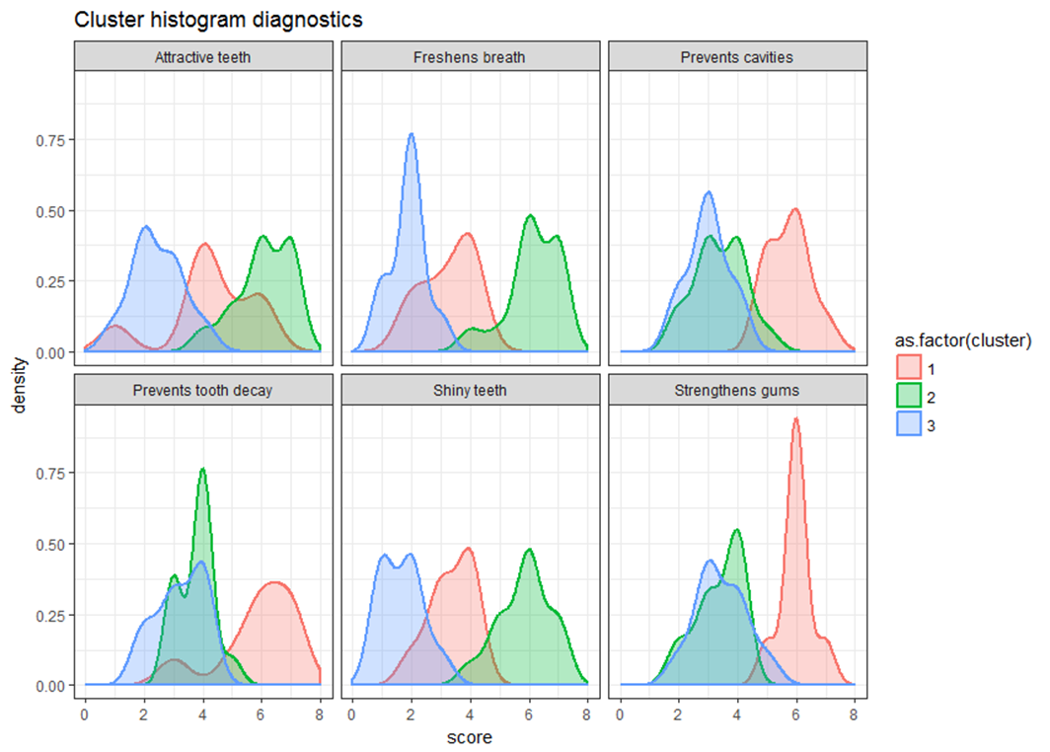
Cluster Analysis: Diagnostics
We can use the histogram diagnostic plot to analyze the distribution of the attitudinal measures (V1 to V6) of the clusters created by k-means.

Slide 12
Cluster Analysis: Alternative Solutions
Cluster sizes:
> k$size
[1] 8 13 9
Cluster means:
> round(sapply(c("V1", "V2", "V3", "V4", "V5", "V6"), function(n) k$centers[, n]*sd(gums[,n]) + mean(gums[,n])),4)
V1 V2 V3 V4 V5 V6
1 3.38 5.75 3.25 6.00 4.25 5.88
2 5.85 3.38 6.15 3.38 6.08 3.77
3 1.67 3.00 1.89 3.44 2.44 3.22
3-Cluster Solution
Alternatively, a two-cluster solution may be investigated using the same procedure above; Specify 2 as the K-means number of clusters, then compare the 2-group solution to the 3 groups.
Cluster sizes:
> k2$size
[1] 17 13
Cluster means:
> sapply(c("V1", "V2", "V3", "V4", "V5", "V6"), function(n) k2$centers[, n]*sd(gums[,n]) + mean(gums[,n]))
V1 V2 V3 V4 V5 V6
1 2.47 4.29 2.53 4.65 3.29 4.47
2 5.85 3.38 6.15 3.38 6.08 3.77
2-Cluster Solution
Shiny Teeth
Prevents Cavities
Freshens Breath
Strong Gums
Attractive Teeth
Prevents Tooth Decay
Notes:
What changed from 3 clusters to 2?

Slide 13
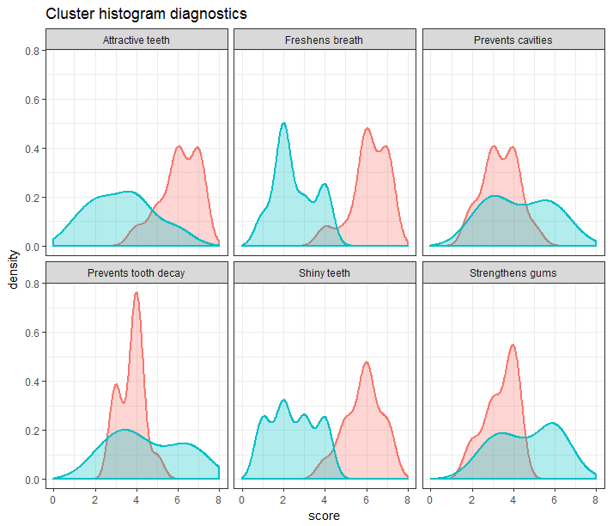
Cluster Analysis: Alternative Solutions
3-Cluster Solution
2-Cluster Solution
Notes:
Which one do you think looks best? (Do a general vote and ask for details)

Slide 14
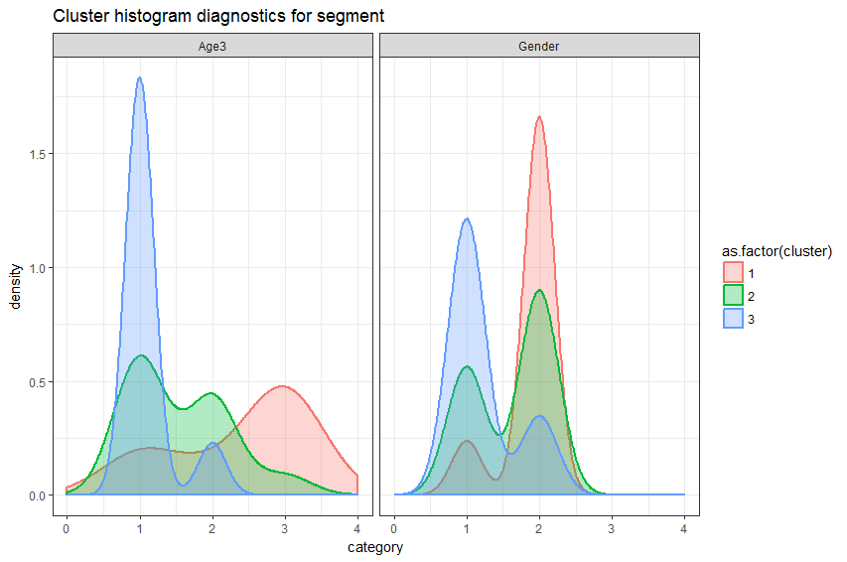
Cluster Analysis: Who are in the Clusters?
We use the histogram diagnostic plot to analyze the distributions of demographics of the clusters created by k-means.
We could also conduct cross-tabs to see whether the cluster membership significantly associates with age and gender.
This will help with targeting the desirable segment(s).
Cluster | Psycho | Demo
1 | Healthy | Female, older
2 | Cosmetic | Young
3 | Casual | Mostly male

Slide 15
Describing the Segments: Crosstabs
Cell Contents
|-------------------------|
| N |
| Expected N |
| Chi-square contribution |
|-------------------------|
Total Observations in Table: 30
| gums$gender
gums$segment | male | female | Row Total |
-------------|-----------|-----------|-----------|
casual | 7 | 2 | 9 |
| 3.900 | 5.100 | |
| 2.464 | 1.884 | |
-------------|-----------|-----------|-----------|
cosmetic | 5 | 8 | 13 |
| 5.633 | 7.367 | |
| 0.071 | 0.054 | |
-------------|-----------|-----------|-----------|
healthy | 1 | 7 | 8 |
| 3.467 | 4.533 | |
| 1.755 | 1.342 | |
-------------|-----------|-----------|-----------|
Column Total | 13 | 17 | 30 |
-------------|-----------|-----------|-----------|
Statistics for All Table Factors
Pearson's Chi-squared test
------------------------------------------------------------
Chi^2 = 7.571354 d.f. = 2 p = 0.02269349
Can we describe these segments using demographic data?
Yes! Conduct crosstabs of gender and cluster membership
Null hypothesis (H0): There is no assocation between gender and cluster membership.
We can use the CrossTabs() function from the gmodels package in R
3 cells out of 6 (50%) have expected count less than 5

